Slide 1
Materialise Education Program

Slide 2
Why
What
For Whom
Equip educational institutions with best-in-class AM software
Empower the AM professionals of the future
Ensure graduates get employed by the different AM industries
Complete Magics and 3-matic classroom packages
Symbolic price of less than 1% of commercial offer
Syllabus for class preparation and teaching (300+ pages course material)
Full classroom set-up (20+ floating licenses)
Annual licenses
3-5 years commitment
Universities
Community colleges
Junior colleges
Vocational colleges / schools
Government schools
Homeschools approved by Materialise
Named educational entities approved by Materialise

Slide 3
1 - Data & Build Prep Package
2 - Engineering Package
Base pack | Option
Magics RP base | Base configuration + e-Stage (plastics and metal)
All imports module
Sinter Module
Structures Module
SG & SG+
Machine Lib. BP
€ 4.000/year (taxes excl.)*
3-matic pack
Design Module
All imports module
Texturing module
Lattices module
Remesh module
CAD-link module
3 – All-in (Data & Build Prep Package + Engineering Package)
*Package can be used for up to 20 floating licenses

Slide 4
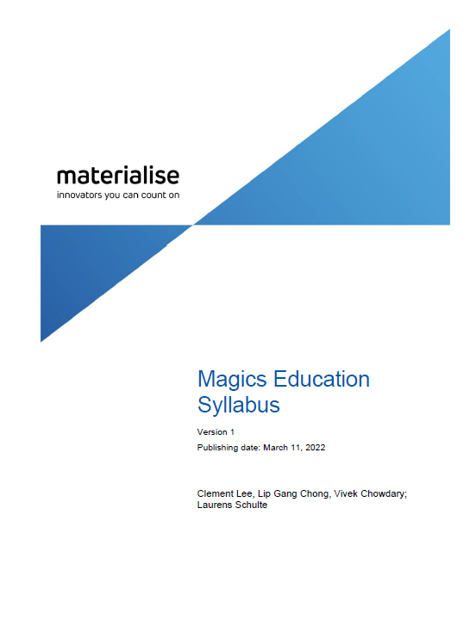
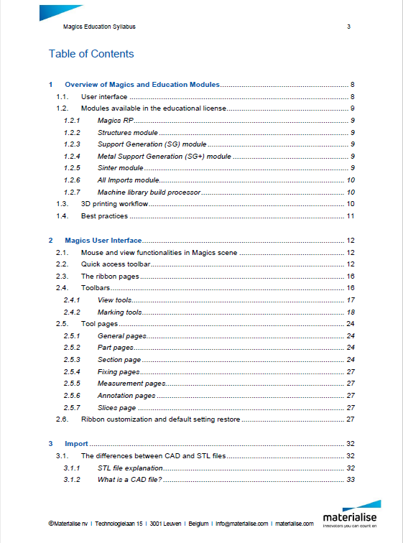
+300 pages course Material on Magics software
Developed by Materialise application engineers for professors for class preparation
Comprehensive and user-friendly

Slide 5
Magics Module Overview (click on the image to visualize)
3-matic Module Overview (click on the image to visualize)

Slide 6
Interested in learning more or receiving a quote? Contact us!

